Slide 1
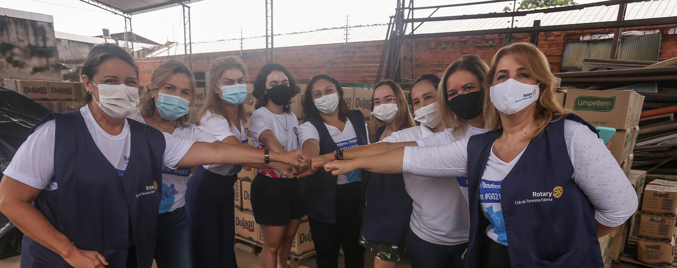
MEMBERSHIP TRENDS, INSIGHTS, TOOLS
September 2023
Avenues of Service
Rotary District 5170 Membership Chair: Camilla Boolootian

Slide 2

Agenda
Rotary International Membership Trends
Insights on joining, staying and leaving
Insights on membership satisfaction and retention
Onboarding and membership stewardship for success
You belong Here Campaign
What is your experience?

Slide 3
Regional Membership Trends
2010-2022
+30%
(22%)
(3%)
(9%)
(34%)
(28%)
Notes:
But we also know, that membership is growing in some regions, while stagnant or in decline in others. So let’s take a quick look at the regional composition of our Rotary Club membership.
Here you can see Asia has grown by 30% in the last 12 years, while RIBI has declined by 34%, Australia, New Zealand and the Pacific Islands by 28%, and the US, Canada and Caribbean by 22%.
You also have a series of regional membership trends graphs included in your advance materials for a little more detail on where our membership is growing, where it is stagnant, and where it is in decline.

Slide 4



Why Members Leave
Club Environment & Culture
Unmet Expectations
Financial & Time Commitments
Notes:
And when we ask recently terminated members why they leave, they generally cite three primary reasons. So, club environment and culture are crucial to the club experience for all members. For Rotaractors, financial and time commitments also play a role in whether a Rotaractors is likely to remain or leave their club. But this reason is also a function of the value one receives in exchange for their time and financial support.

Slide 5
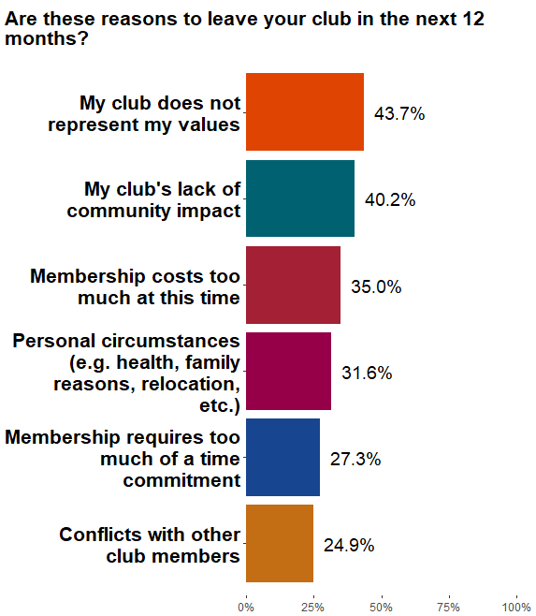
Why Rotarians are Thinking of LeaVing
Because their clubs do not represent their values, their club’s lack of community impact and membership costs.
Notes:
According to the survey results, the two factors related to the club experience were also the top reasons why Rotarians were thinking about terminating their memberships. This is the response to the question “Are these reasons to leave in the next 12 months?” Over 40% of those who said they were thinking about leaving Rotary said that their club does not represent their values and their club’s lack of community impact were reasons to leave.

Slide 6
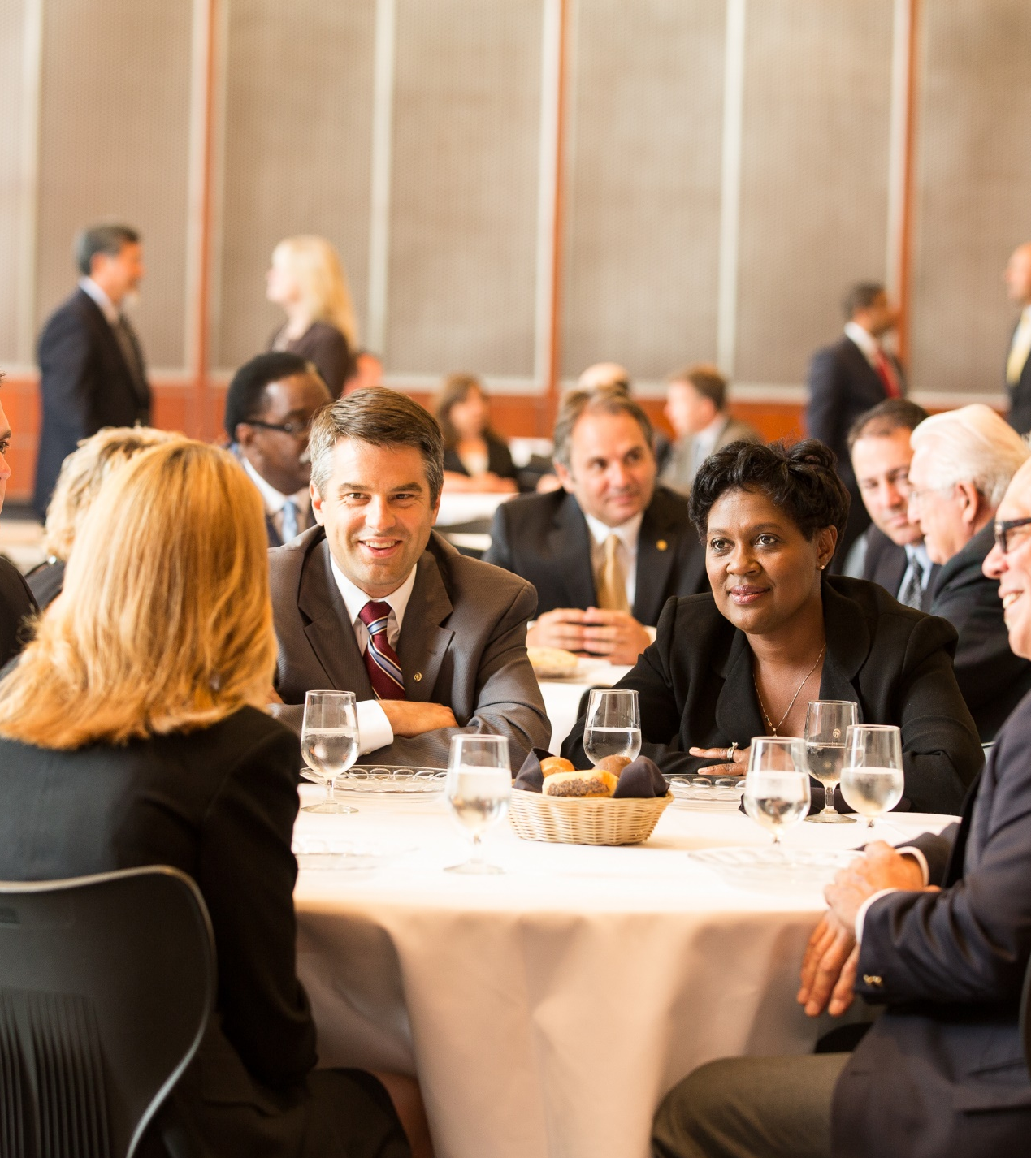
Drivers of Member Satisfaction & RETENTION
Comfort with other club members
Club’s positive impact in the community
Confidence in club leadership
Enjoying club meetings
Notes:
Feeling welcomed and comfortable is the single most important variable when it comes to both member satisfaction and member retention. As comfort increased, the probability of having a higher satisfaction with membership increased as well.
In fact, a member who is not at all comfortable with other members is two to four times more likely to terminate their membership than a member who is extremely comfortable.
It is also important that members enjoy their club meetings, that the club have good leadership, and that the club be active in the community.

Slide 7

Why Members Join & Stay
Community
Service
Friendship &
Fellowship
Professional Connections
Personal
Growth
Leadership Skills
Intl Service
Other
Join
45%
16%
12%
12%
6%
4%
3%
Stay
42%
38%
4%
6%
1%
3%
5%
Notes:
In our last round of surveying, Rotarians and Rotaractors placed slightly different levels of importance on their reasons for joining and staying, but generally there is consistency in what drives our members to get involved, and they really boil down to these three primary reasons. Local service, connecting with others, and professional and leadership development opportunities.
When we asked why they joined or stayed, both new and current club members (including both Rotary and Rotaract Club members) said “to participate in community service.”

Slide 8
Most important factors for overall Rotarian satisfaction:
Meeting Enjoyment
Confidence in Club Leadership
Satisfaction with Club Service
Satisfaction with Finding Friends
Club’s positive impact in the community
OVERALL CONCLUSION:
THE CLUB EXPERIENCE MATTERS MORE THAN ANYTHING ELSE
Notes:
Here is the overall conclusion of this presentation.
Rotarians experience Rotary primarily through the club. If Rotarians’ club experience is somehow lacking, they will not see enough value in Rotary to stick around. If new Rotarians join clubs that don’t meet their expectations and don’t integrate them into activities, chances are they will leave despite what Rotary offers outside of clubs.

Slide 9
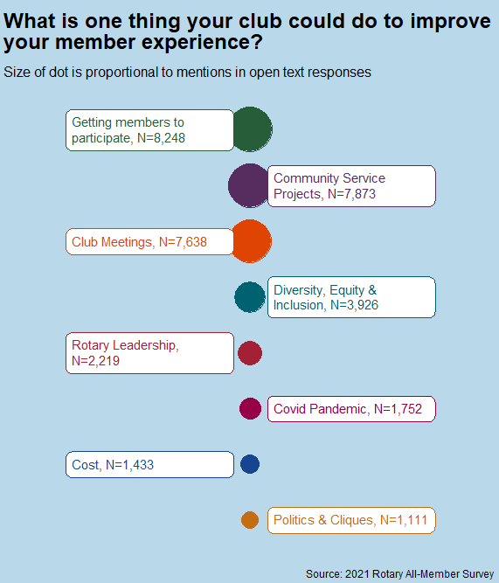
Improving the MEMBER Experience
Getting members involved in meetings and service projects
More community service projects
Improve club meetings through things like better speakers and time management
Notes:
How can Rotary improve the Rotarian experience? By getting Rotarians involved in club activities.
How do we get Rotarians involved in club activities? By getting them excited about club activities through more community involvement and more enjoyable meetings.

Slide 10
STRATEGIC PRIORITIES GROW ROTARY
INCREASE IMPACT
EXPAND REACH
ENHANCE ENGAGEMENT
INCREASE ABILITY TO ADAPT
Today’s Focus: ENGAGEMENT / RETENTION
ATTRACTION / AQUISITION
NEW CLUBS / NEW CHANNELS
Notes:
With our remaining time together, I wanted to highlight just a few key initiatives we are working on in Membership Development, intended to move our Action Plan forward, so we can Grow.
Because, when we grow our membership through existing and new clubs, we have more people of action, with unique and diverse skillsets, to increase our impact. Growing our membership allows us to expand our reach into new and underrepresented segments of our communities. A growing membership enhances the engagement of all members and participants as they expand their networks and develop new friendships; and it increases our ability to adapt as new and more engaged members introduce new ideas and ways of thinking into our organization.

Slide 11
Tom Hart
Retired Healthcare V.P Strategy and Facility Planning Sutter Health- Santa Cruz
Joined Rotary Club Santa Cruz 1983
Joined Santa Cruz Sunrise 1991
Past Club President 2013-2014
Current Co-Chair Membership
Rotary Club of Santa Cruz Sunrise

Slide 12
Sponsor/Mentor Guidelines
Rotary Club of Santa Cruz Sunrise
The Rotary Club of Santa Cruz Sunrise Sponsor/Mentorship Program is an important part of the Membership Committee. It is designed to ensure new members are successfully assimilated into the club, advance to Blue Badge and be engaged.
Name:
email:
Induction date:
Sponsor name:
Mentor name:
Sponsor/Mentor Guidelines -.
Shortly after new member’s induction, meet with them away from club meeting and get to know them better.
Encourage them to explore and join a committee that best suits their personal interests. Use the google doc committee link (found on Club Runner Home page Membership tab) to review all the avenues of service.
Sit with them at club meetings (try different table each week) and introduce them to a variety of club members. If you cannot attend a meeting, arrange for another member to help welcome them.
Attend club functions such as club socials, district events and visitations to other clubs. If you are unable to attend above events, arrange for another member.
Review the annual calendar so they can see the opportunities for service, fellowship and fun.
Encourage participation in club projects and fundraisers.
Take time to answer their questions and review and discuss club and district activities.
Periodically meet and review google doc Red Badge Check List progress.

Slide 13
Sponsorship/Mentor Guidelines continued
Red Badge guidelines
During the Red Badge phase of your membership, your Sponsor/Mentor, along with the Red Badge Team are available to you to answer questions and guide you through the Red Badge Check List.
Communicate with your Mentor(s) regarding your Sunrise Rotary expectations – let your Sponsor and Mentor know what you want from your Rotary experience.
Your Sponsor introduced you to the Club and will always be your first “friend” in Rotary. Your Mentor is present to help you form additional life-long friendships as you discover your passion for Service Above Self.
Measuring Success:
Red Badger is making progress toward completion of the Red Badge Check List.
Red Badger continues to participate in social events, club service and/or service project, and district events.
Red Badger is active and engaged in Sunrise service opportunities.
Red Badger continues to support The RF each year.
Complete 6 month membership survey
Resources:
Red to Blue Resources
Annual Calendar
Committee List
Acronyms/Glossary
CR app for smart phone
Home Page - Membership Tab
Co-Presidents, Board members, Membership Co-Chairs, Sponsor and Mentors

Slide 14
Red Badge Check List – Santa Cruz Sunrise
New member:
 | Description | Date | Task
 | Induction |  | Sponsor and Red Badge Scheduled by Program Chair and President, receive badge, pin, 4 way test and Objectives of Rotary
 | Welcome Letter |  | Letter From Club Secretary Jon Winston
 |  |  | Club Runner Access and overview with sponsor, mentors, Membership Co-Chair
 | Red Badge Orientation |  | Sponsor, Mentor and Membership Co-Chair- go over Checklist, Mentorship Program, Acronyms
 | Photo Taken |  | See Roger Swenson or take one yourself and post
 | Pay Dues |  | Club and The RF (separate checks)
 | Club Service
 | Greeter |  | Serve as Greeter-introduce yourself, welcome members, guests
 | Pledge/Invocation |  | Lead club in Pledge and give a non-religious thought of the day to be inspirational, motivational, remembrance etc
 | Assist Secretary |  | Sit with Secretary, introduce self, help sell raffle tickets, welcome members and guests
 | Bio |  | Give 7-10 min personal background talk
 | Share a moment |  | Optional - not part of Red Badge Requirements
 | Help with Room Set-up/take down |  | Arrive early or stay late to help with room set up take down
 | Rotary Engagement
 | Board meeting |  | attend one board meeting
 | Visit clubs |  | visit 2 clubs
 | Committee |  | review list of committees with Sponsor/mentors and join
 | District Event |  | attend District Event
 | Youth Protection |  | Log into RI Youth Protection Program and complete certification
 | Sponsor
 | Mentor

Slide 15
Rotary International (English) deploying a new touch-points pilot
Send Date | Message & Call to Action
Day 1 of Admit | Welcome to Rotary; Video; Create a My Rotary account
Day 7 after Admit | Rotary Basics; Ideas for new members
Day 30 after Admit | Get more out of your membership; interactive questionnaire to present specific resources and opportunities relevant to individual user
Day 90 after Admit | Make an Impact, Find Connections; Polio, Rotary Action Groups, Rotary Fellowships
Day 180 after Admit | The Rotary Foundation; Rotary Direct; Donor recognition opportunities
Day 365 after Admit | Happy Rota-versary; Refer a new member
Notes:
To complement the work that our clubs and districts are doing to help engage members, Rotary International has deployed a new effort to connect with new members directly, with multiple, strategic touch-points over the course of their first year of membership.
All new members will receive a series of messages from Rotary over the course of their first year of membership, to help introduce them to the broad menu of opportunities to get involved and derive value out of their membership – particularly beyond their own club.
We are first launching this in English, and will then be adding additional languages once we’ve ensured everything is working properly.
Here you can see a high-level overview of what this new member engagement campaign will look like.

Slide 16

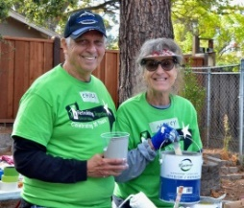
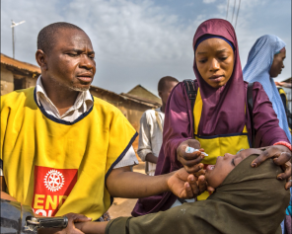
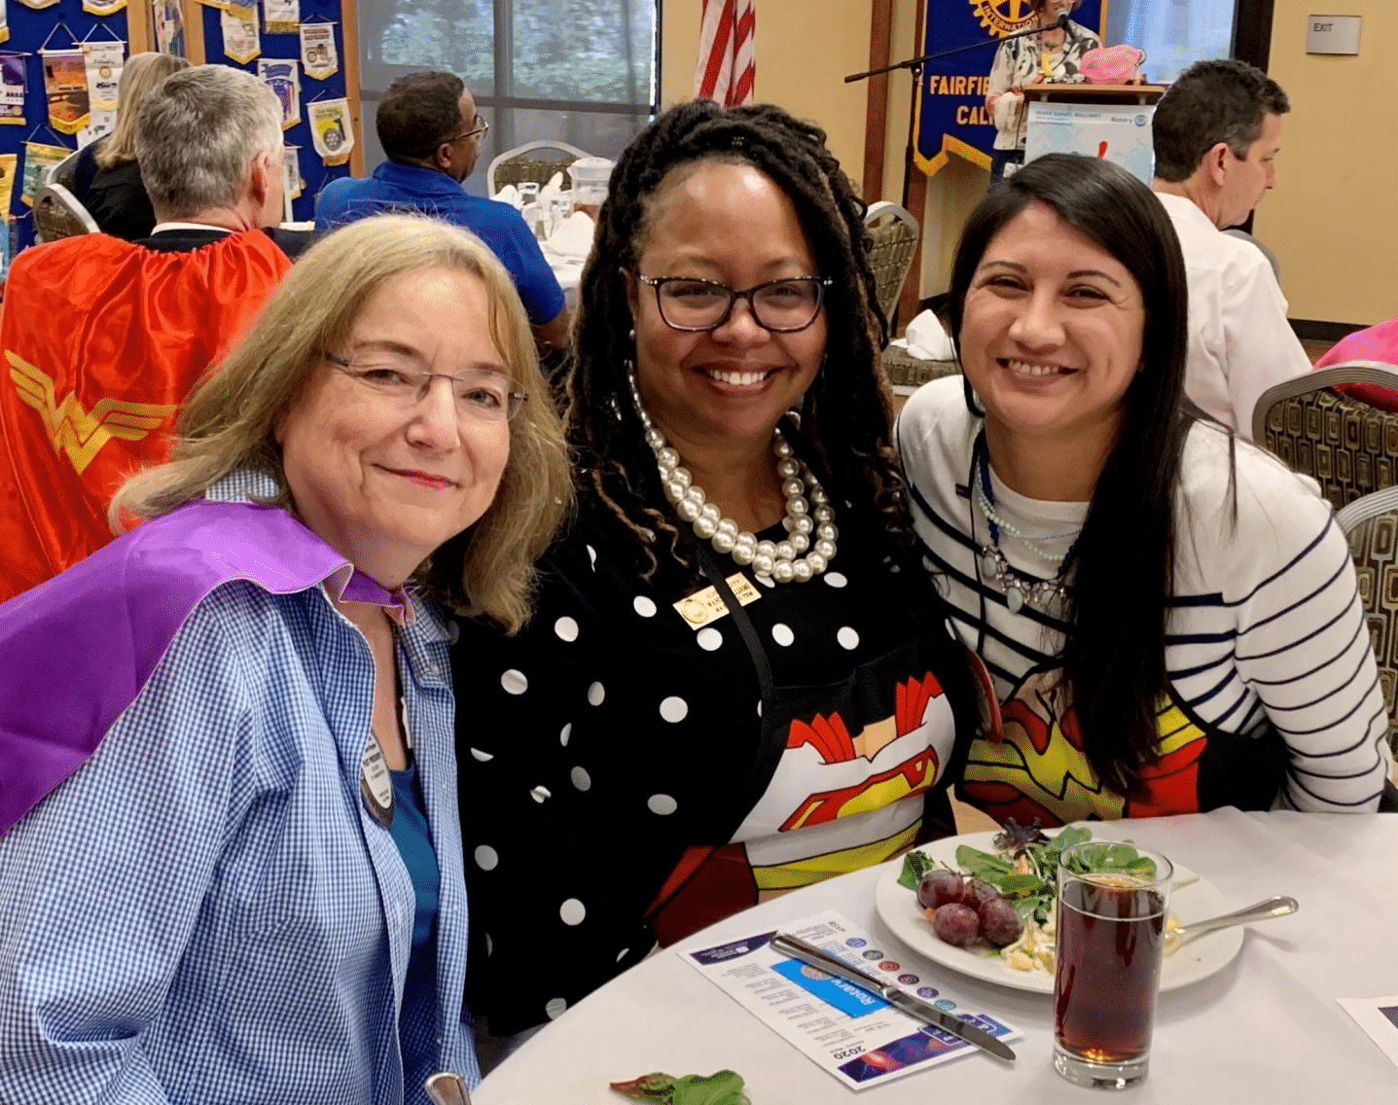
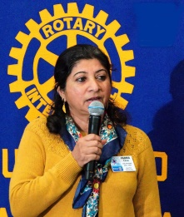

With Rotary you can:
Leverage your efforts, working together to make a lasting change in your community
At Rotary, there’s a place for every person and every interest. For over 100 years, Rotary has led the way in service, leadership, and friendship. We’re an organization of 1.5 million diverse leaders that spans over 33,000 Rotary clubs in more than 200 countries.
Change lives around the world, providing clean water, disease prevention, and conflict resolution.
Join us and You will:
Effect change within your community
Form new friendships and build your network
Make a global impact
Gain new skills and grow as a leader
Make new friends and business connections from a diverse group of people working toward a common cause.
Develop skills in project management, public speaking, fund raising, and leadership

Slide 17

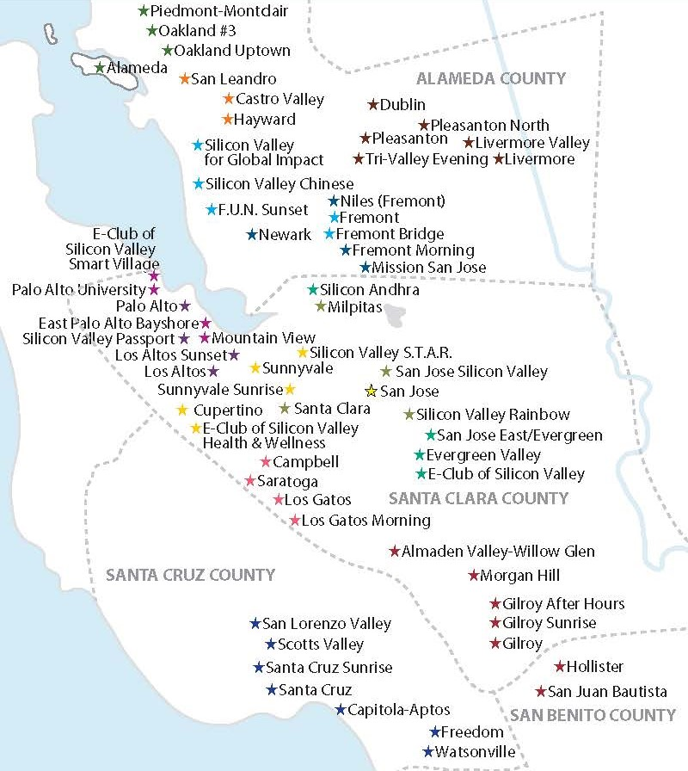
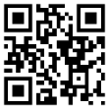
Come Explore Rotary
We have 62 clubs in the Bay Area and counting. Take your pick. Let us know what time, place and date suits you. We will help identify a club for you.
District 5170 welcomes you
Scan using your cell phone and submit an interest in exploring any Rotary club.
Go to RotaryDistrict5170.org for more information about what we do.

Slide 18

Let’s reflect on these questions in relation to your Club:
Why did you join Rotary?
What does your club do really well to keep people engaged in Rotary and your club?
Does your club have a formal onboarding and mentoring program to engage new Rotary Members or re-engage longtime members.
What community projects does your club participate in where they also engage the community? Do you invite participants to join your Rotary club?
Has your club done any extraordinary efforts to attract new members? Created a Satellite Club, changed meeting times or venues?
What keeps you engaged and active in Rotary?

